Slide 1
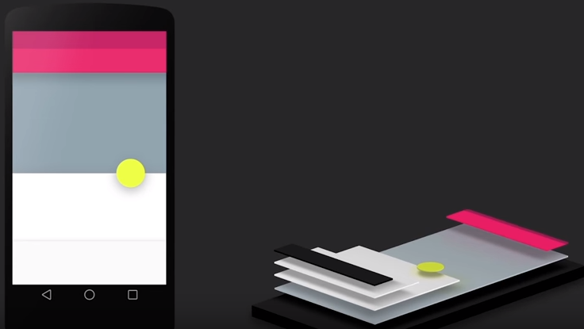
Google’s
Material Design
Corbin Skelton

Slide 2
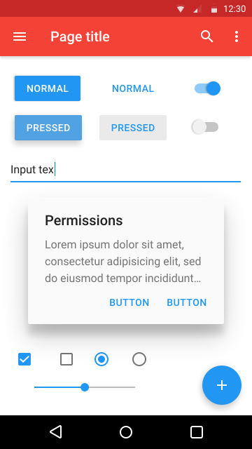
What is it?
Google’s UI design language
Codename: “Quantum Paper”
Digital material inspired by paper & ink
Huge in Android mobile apps

Slide 3
Goals
“Create a visual language that synthesizes classic principles of good design with the innovation and possibility of technology and science”
“Develop a single underlying system that allows for a unified experience across platforms and device sizes”

Slide 4
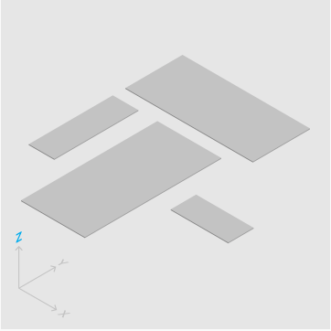

3D Space
All objects have x, y, and z dimensions
Material has varying x & y dimensions, but a uniform z dimension

Slide 5
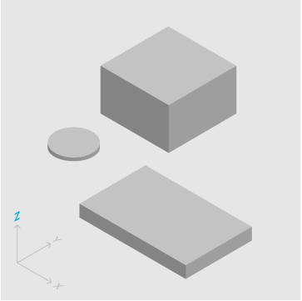

3D Space
Each sheet of material occupies single position along z-axis with a standard thickness of 1dp
Dp = density-independent pixels

Slide 6
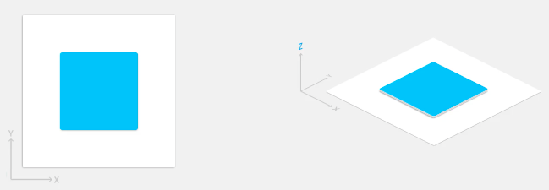
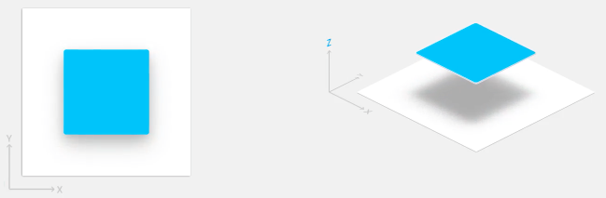
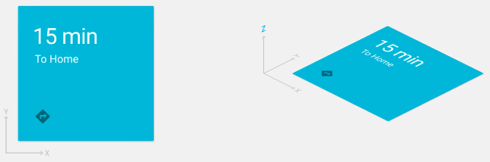
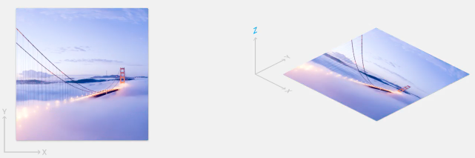
Other Properties
Shadows result naturally from relative elevation
Material displays any shape and content

Slide 7
Other Properties
Material does not pass through other material
Material is spontaneously generated or destroyed (e.g. submenus)
Material can transform (change shape)
Z-axis motion typically the result of user interaction with material

Slide 8
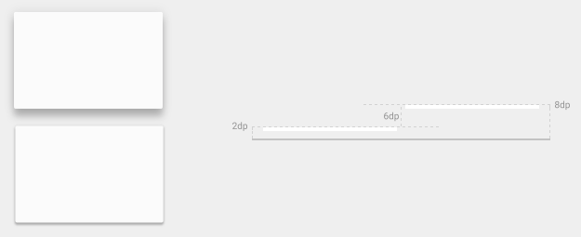
Elevation
Relative distance between 2 surfaces along z-axis
Indicates parent-child hierarchy

Slide 9
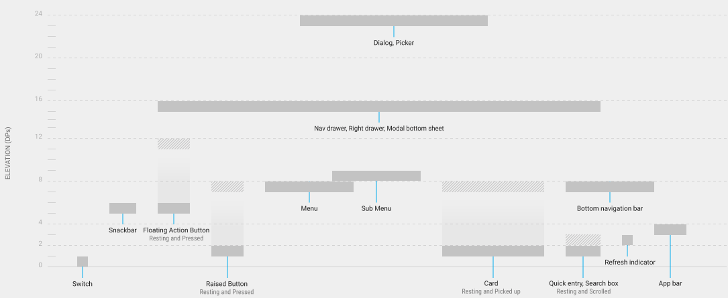
Elevation
Material has resting elevation and dynamic elevation offsets

Slide 10
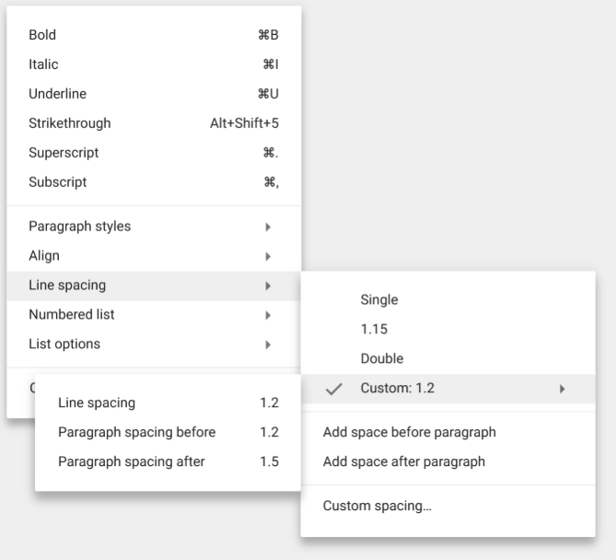
Shadows
Provide visual cues about objects depth and directional movement
The only visual cue indicating amount of separation between surfaces
Elevation determines appearance of shadow

Slide 11
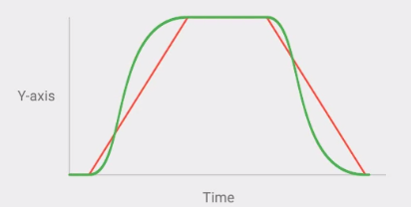
Animation
Authentic Motion – Objects move depending on mass and weight. Objects are described by their motion.
Acceleration and deceleration are smooth and draw attention to the user

Slide 12
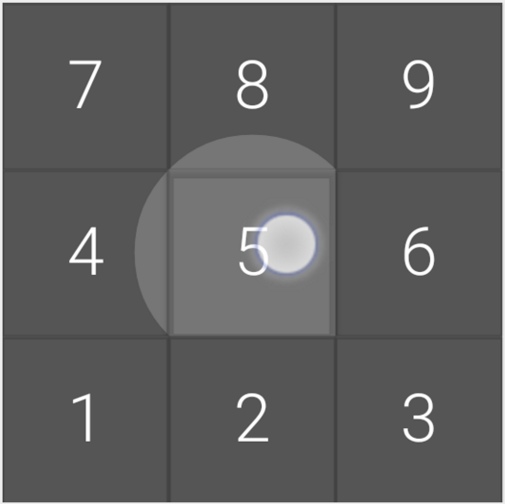
Responsive Interaction
Material reacts to user input
Instant visual confirmation at the point of contact (e.g. the Touch Ripple)
Material can be lifted, dragged, flung based on touch

Slide 13
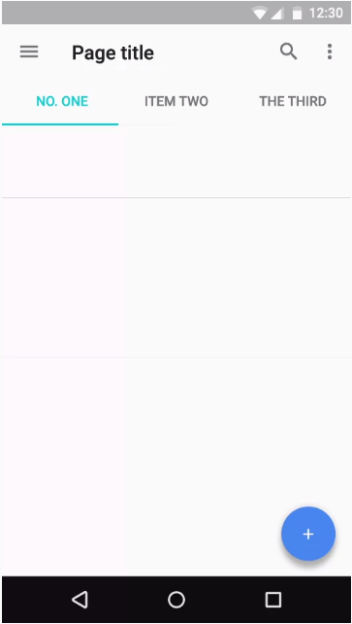
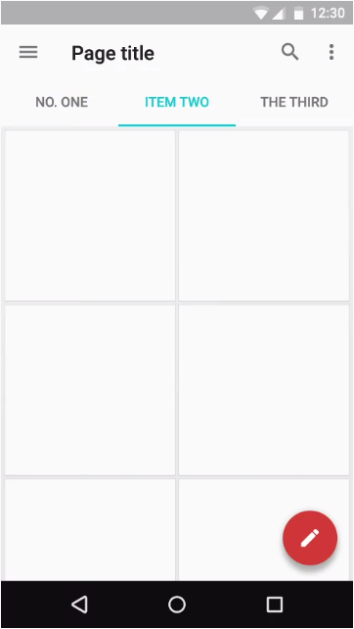
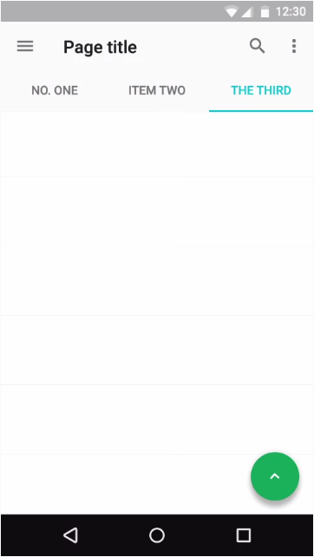
Floating Action Button (FAB)
Distinguished circled icon floating above the UI
Anchor point from which common behavior is launched

Slide 14
Main Tenets
Simplistic, consistent layout and design
Subtle but natural visual cues aid the eye’s navigation around the interface
Material = Sheets = Objects; appear flat but elevated

Slide 15
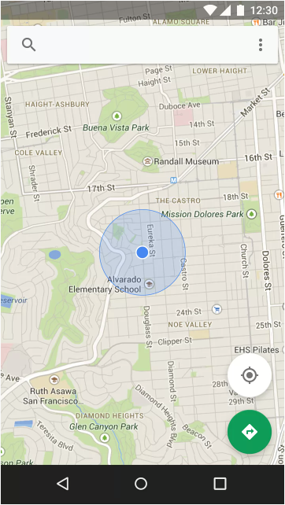
Example
Google Maps
Sheets of Material
Toolbar and FABs are elevated = z-axis value higher than map.
Map can move underneath toolbar and FABs, but not through and above them
Top FAB brings current location back to center
Bottom FAB presents directions

Slide 16

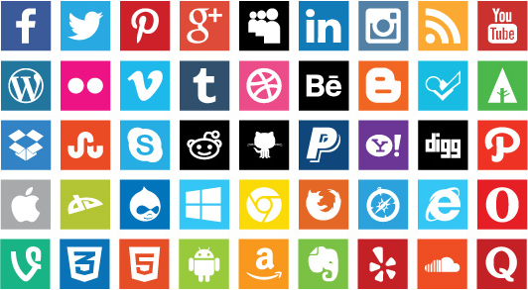
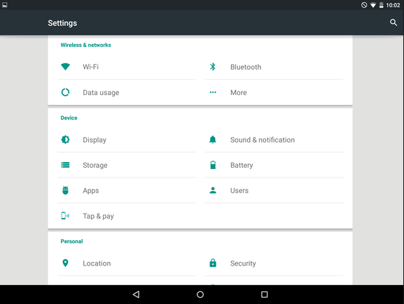
What else?
Flat design
Bold colors
Whitespace

Slide 17
Implementation
Used in Android version 2.1 and newer
All Android devices 2009 and on
Big mobile presence, growing desktop presence
APIs available for developers

Slide 18
Who uses Material Design?
Google (obviously) – Drive, Gmail, Maps, Chrome, Docs, Calendar, Wallet, Play, etc.
YouTube
Slack
Tumblr
WhatsApp
Reddit Sync
Majority of Android Apps recently updated to implement Material Design

